Slide 1
CAPSTONE PROJECT SEOUL BIKE SHARING DEMAND PREDICTION Sundar K

Slide 2
CONTENT
❑ Introduction
❑ Problem statement
❑ Abstract
❑ Data Pipeline
❑ Data Description
❑ Exploratory Data Analysis
❑ Model performed
❑ Model Validation
❑ Challenges
❑ Conclusion

Slide 3
INTRODUCTION
Bike Sharing Systems are healthy and cheap way to navigate from one place to another place. Now with the new methods of electronic sharing and registration, the whole process of bike sharing, from the rental to returning back has become much more automatic and convenient. Through the bicycle sharing system, the users can easily rent a bicycle from one place and return it in another place.

Slide 4
PROBLEM STATEMENT
Currently Rental bikes are introduced in many urban cities for the enhancement of mobility comfort. It is important to make the rental bike available and accessible to the public at the right time as it lessens the waiting time. Eventually, providing the city with a stable supply of rental bikes becomes a major concern. The crucial part is the prediction of bike count required at each hour for the stable supply of rental bikes.

Slide 5
ABSTRACT
The bike sharing system has brought wide convenience to residents in the city and serves as important tools to transport from one place to another place. For the bike sharing companies, they need to know the total users of bike, so they can release suitable number of bikes into the market.

Slide 6
DATA PIPELINE
● Exploratory Data Analysis (EDA): In this part we have done some EDA on the features to see the trend.
● Data Processing: In this part we went through each attributes and encoded the categorical features.
● Model Creation: Finally in this part we created the Linea regression model. This model is being analyzed ,so as to get the best performing model for our project.

Slide 7
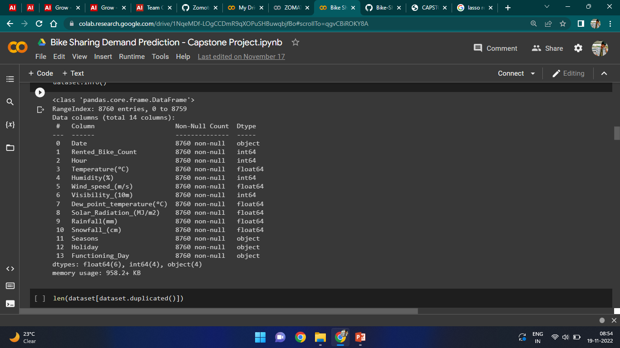
DATA DESCRIPTION

Slide 8
Dependent variable:
• Rented Bike count - Count of bikes rented at each hour
Independent variables:
• Date : year-month-day • Hour - Hour of he day
• Temperature-Temperature in Celsius • Humidity - %
• Windspeed - m/s • Visibility - 10 m
• Dew point temperature – Celsius • Solar radiation - MJ/m2
• Rainfall - mm • Snowfall - cm
• Seasons - Winter, Spring, Summer, Autumn
• Holiday - Holiday/No holiday
• Functional Day - NoFunc(Non Functional Hours), Fun(Functional hours)

Slide 9
EDA
Here its replaced with underscore to know the space within the names in columns
dataset.columns=dataset.columns.str.replace(' ','_')
dataset.columns
And cleared with the null values and NaN values
dataset.replace(np.NaN,0)
Checking for Duplicate values
len(dataset[dataset.duplicated()])

Slide 10
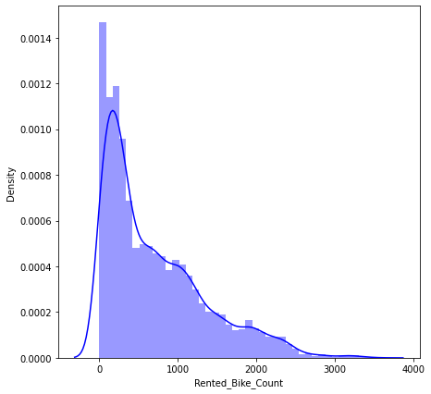
EDA- Count

Slide 11
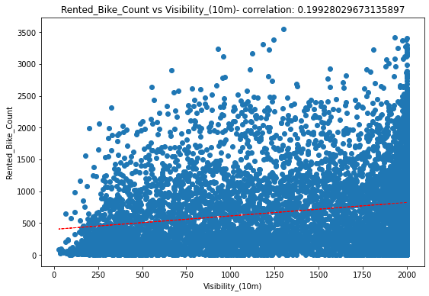
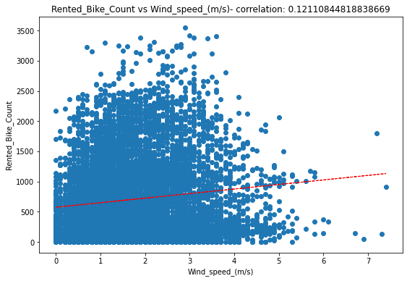
EDA

Slide 12
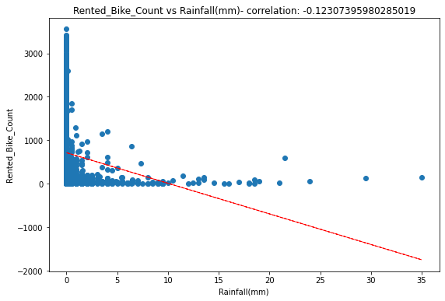
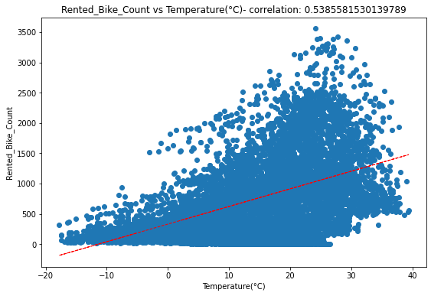
EDA-Count

Slide 13
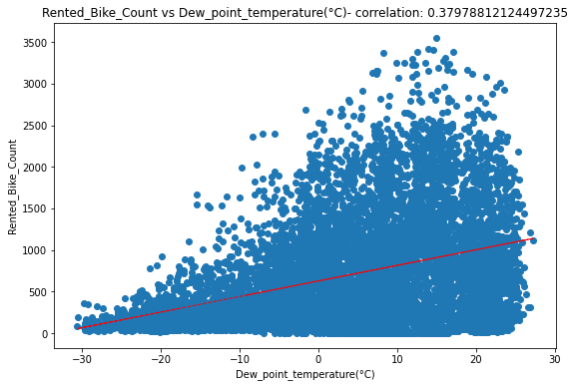
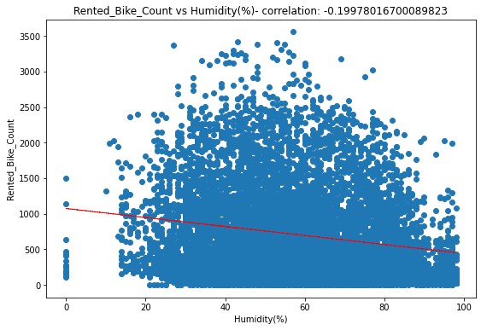
EDA-Count

Slide 14
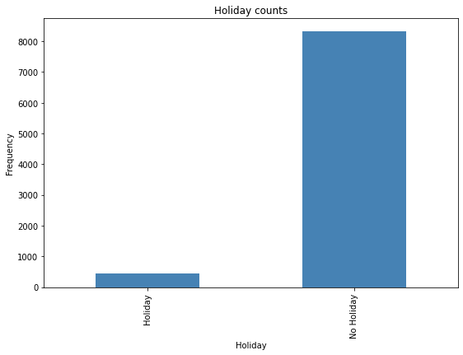
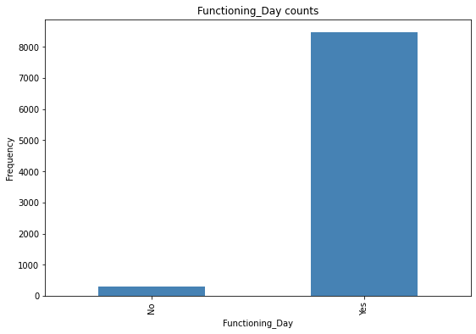
EDA-Count

Slide 15
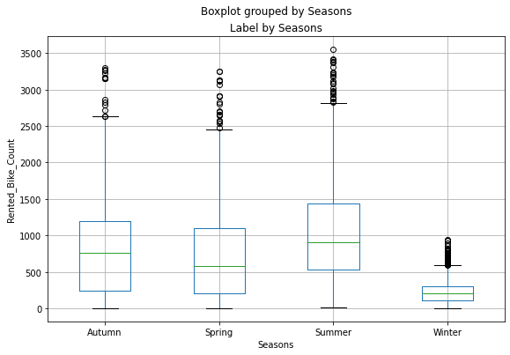
EDA-Count
Less demand on winter seasons

Slide 16
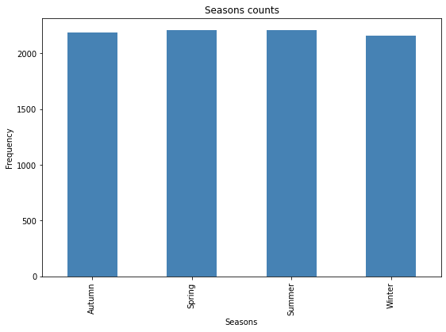
EDA-Count

Slide 17
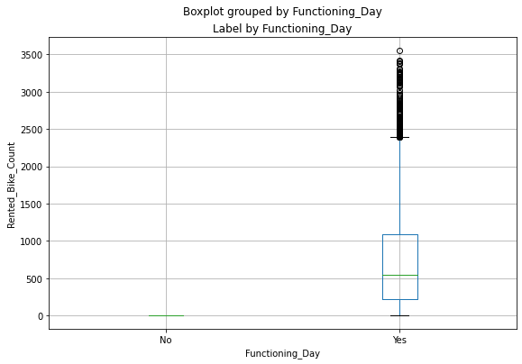
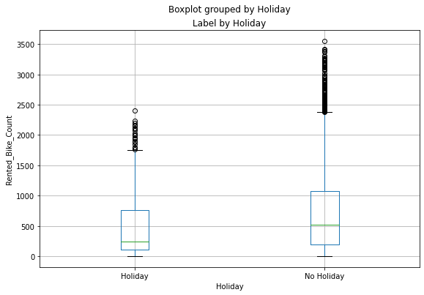
EDA-Count
Slightly Higher demand during Non holidays
Almost no demand on non functioning day

Slide 18
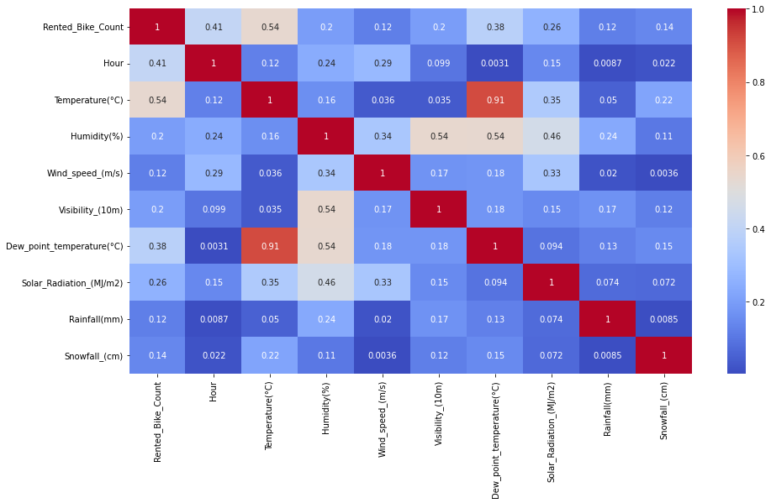
EDA – Feature Correlation

Slide 19
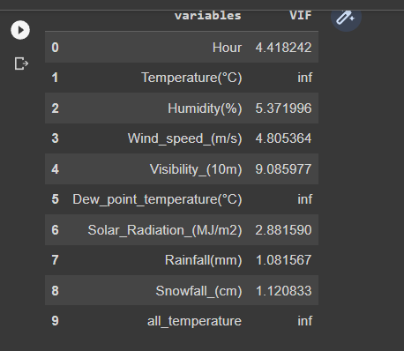
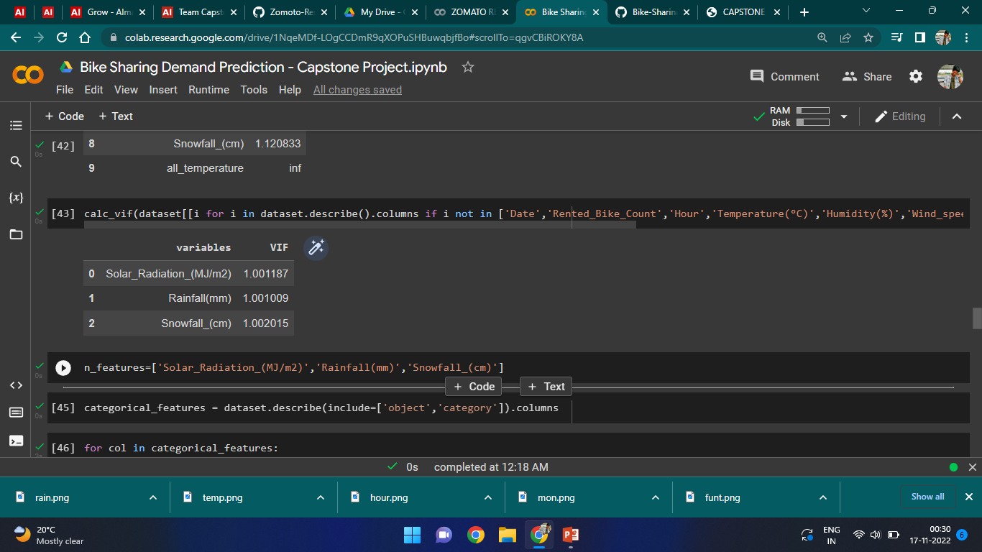
EDA- VIF

Slide 20

Model Performed Linear regression is a supervised machine learning method that is used by the Train Using AutoML tool and finds a linear equation that best describes the correlation of the explanatory variables with the dependent variable. This is achieved by fitting a line to the data using least squares. Resulting linear regression equation:

Slide 21
Result of Performance matrix MSE : 1.4031079173449495e-25 RMSE : 3.745808213650226e-13 R2 : 1.0 Adjusted R2 : 1.0

Slide 22
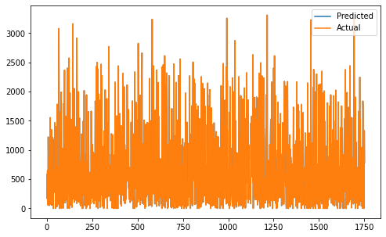
Model Validation

Slide 23
Challenges
● A huge amount of data needed to be dealt while doing the project which is quite an important task and also even small inferences need to be kept in mind.
●As dataset was quite big enough which led more computation time.

Slide 24
Conclusion
It is quite evident from the results that Linear regression is the best model that can be used for the Bike Sharing Demand Prediction since the performance metrics (MSE,RMSE) shows lower and (r2,adjusted_r2) show a higher value
• So, we can use Linear regression

Slide 25
Thankyou

